Slide 1



Introduction to
health technology
By Alice Harling and Sophie Hargreaves

Slide 2

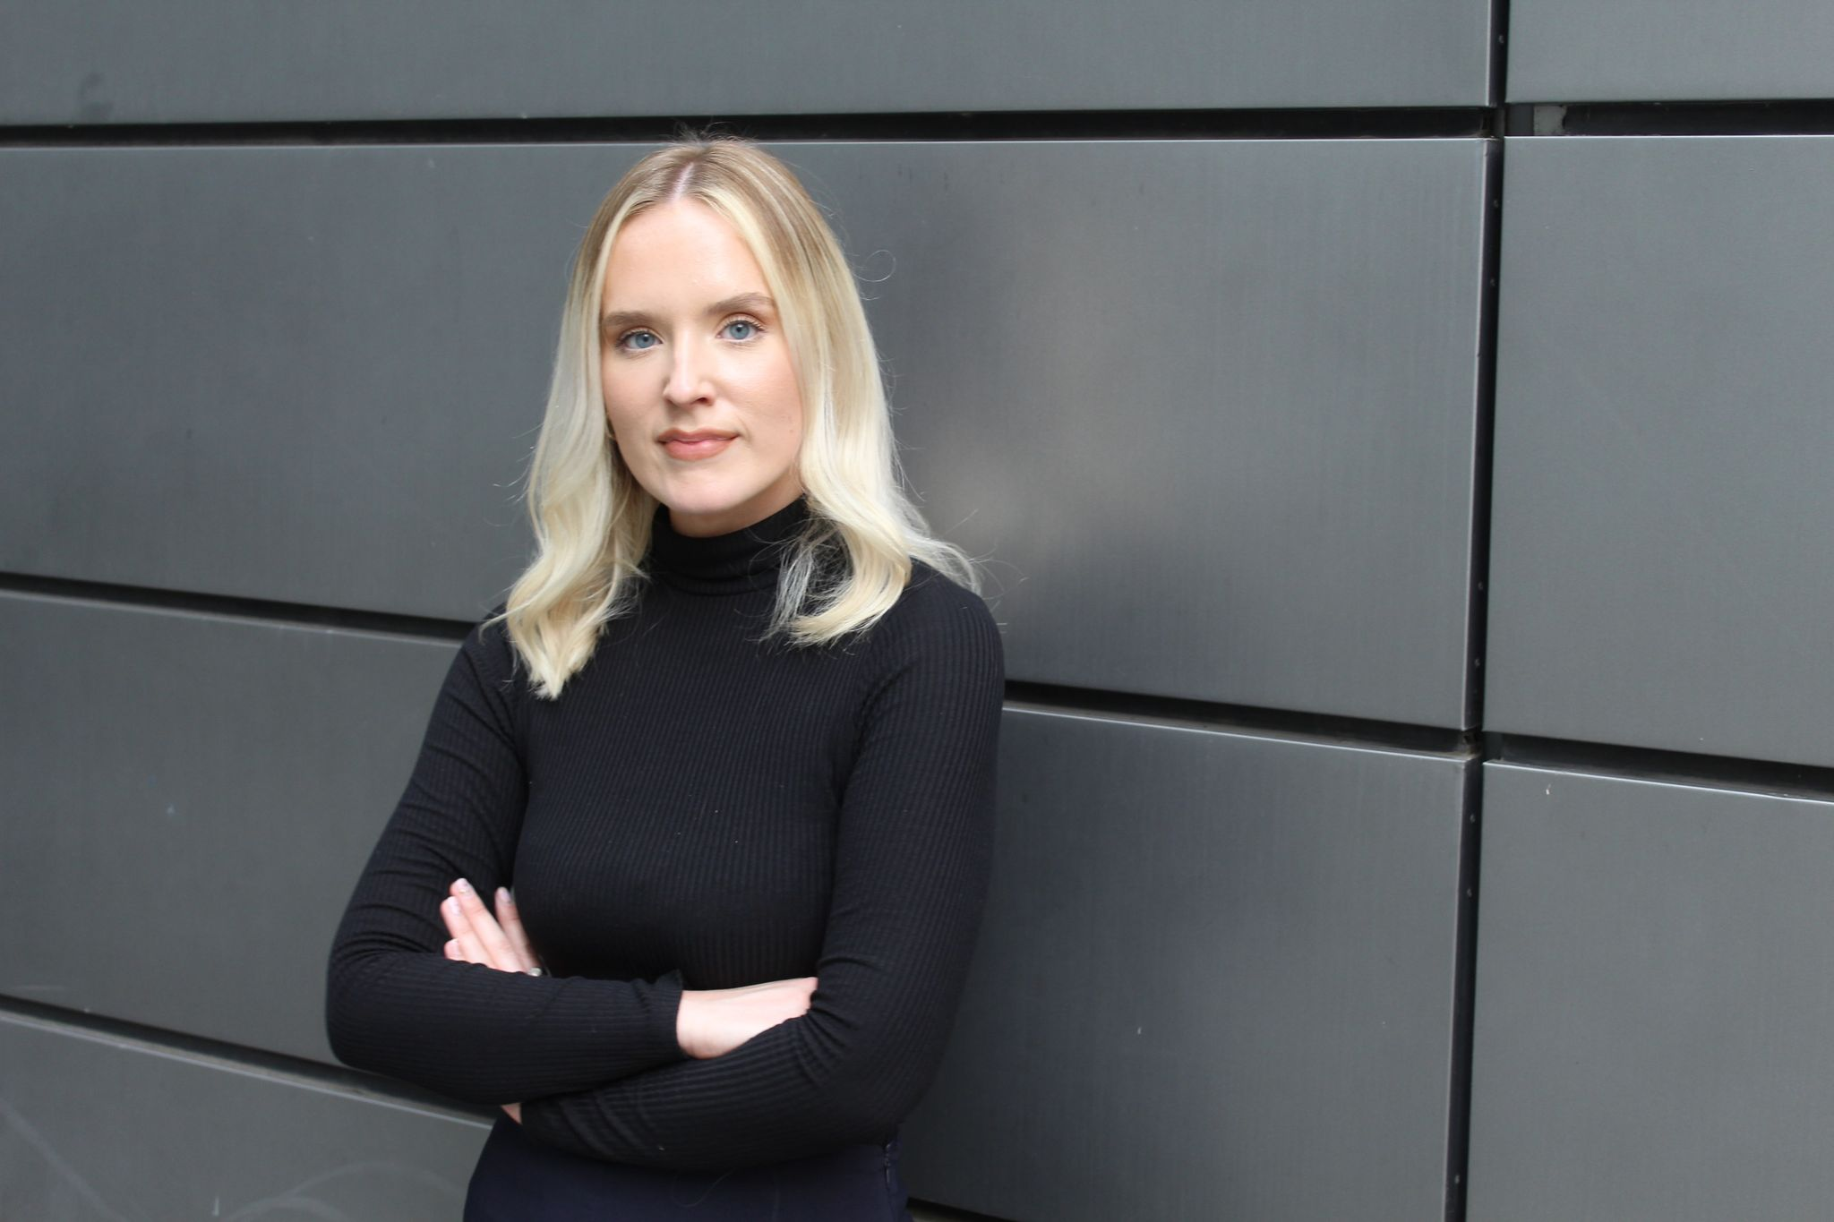
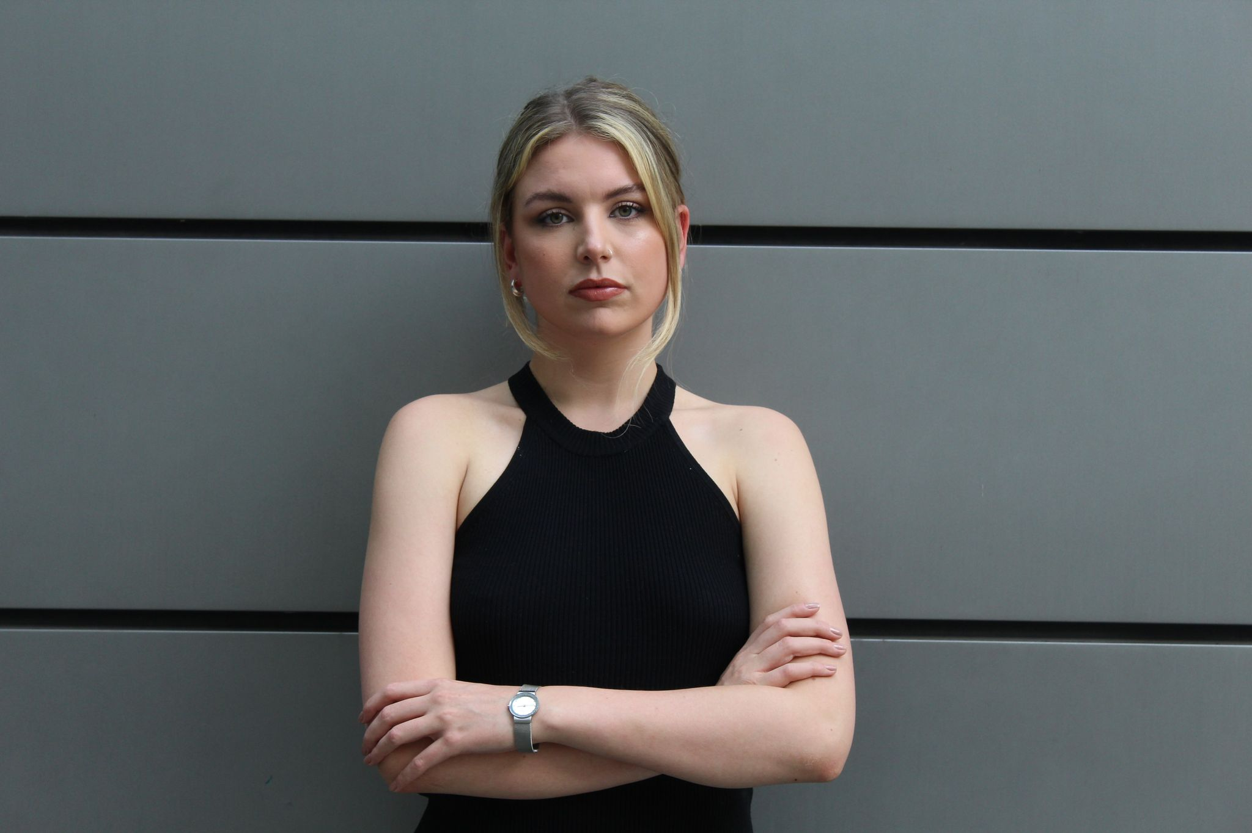






Sophie Hargreaves
Digital Marketing Coordinator
Previous roles: Benefit Cosmetics, Chanel
Alice Harling
Head of Marketing
Previous roles: J B Cole, A S Hospitality, Living Ventures

Slide 3
Contents
Overview of Prevayl
Diversity within the workplace
Why Prevayl was founded
Prevayl technology
Intellectual property
The collaboration of tech and fashion
Building the Prevayl product
Prevayl staff
Prevayl insights
Performance and health
Mental health
How Prevayl will change the industry
The power of women in tech
Competition time

Slide 4
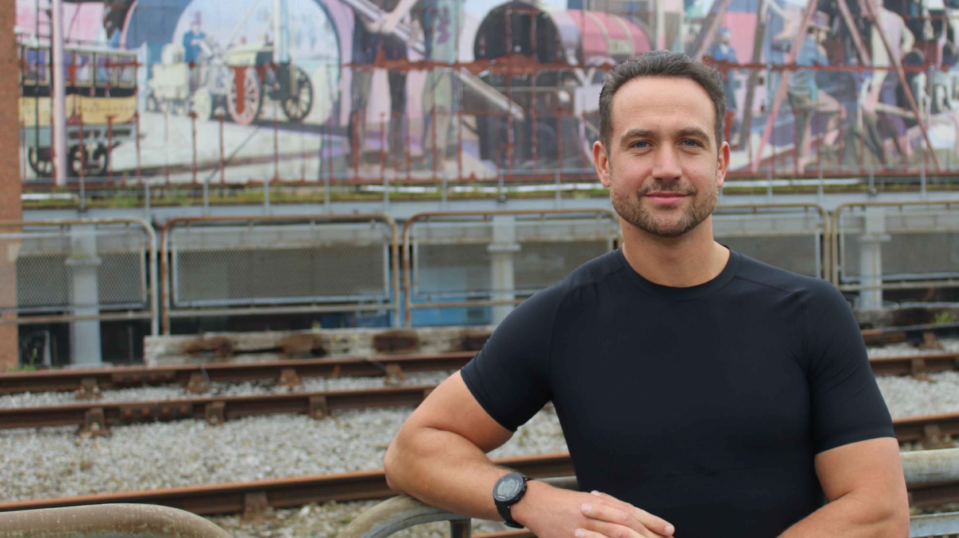
An overview of Prevayl

Slide 5
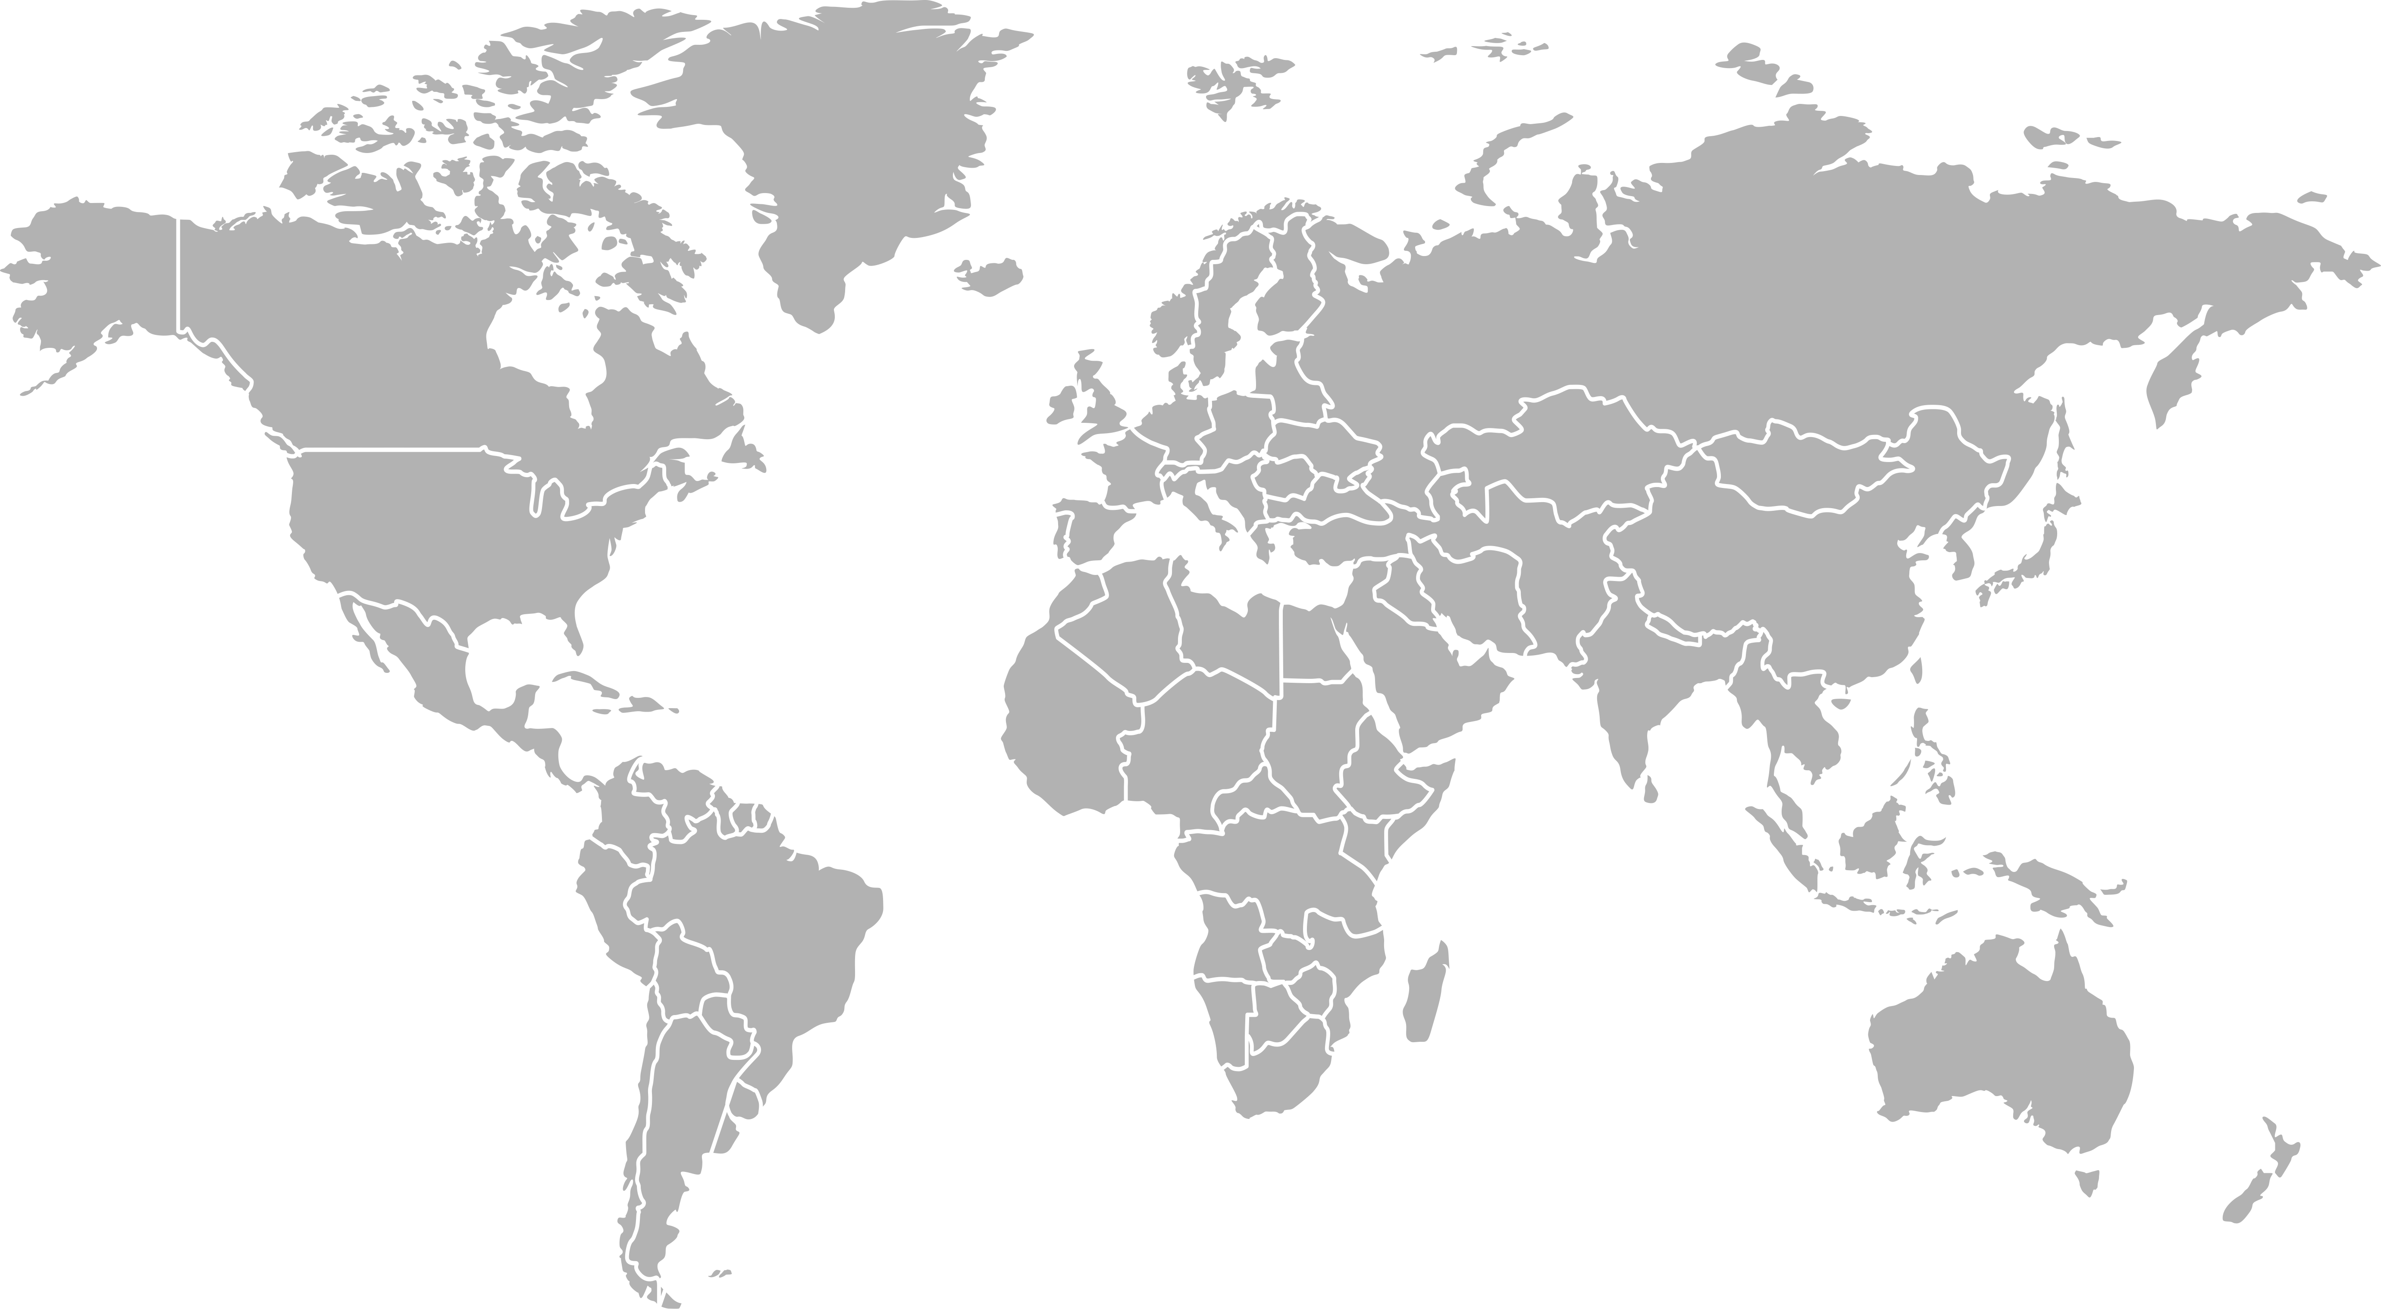
Diversity within the workplace
James Leary, 34 Liverpool
Michael John Lynch, 29 Ireland
Alice Harling, 22 Manchester
Bella Hepworth, 36 France
Ani Goswell, 25 USA
Mark Van Harmelen, ?? South Africa

Slide 6
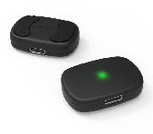
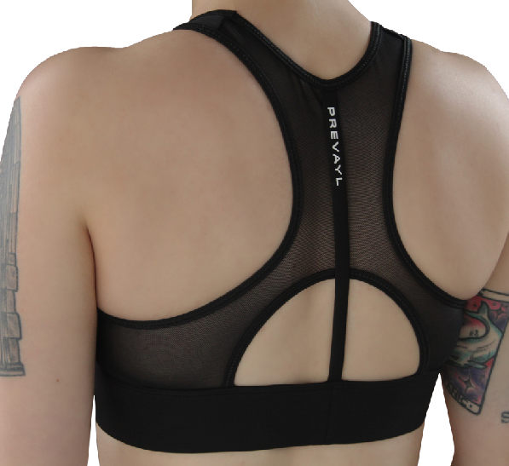
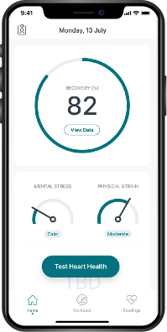
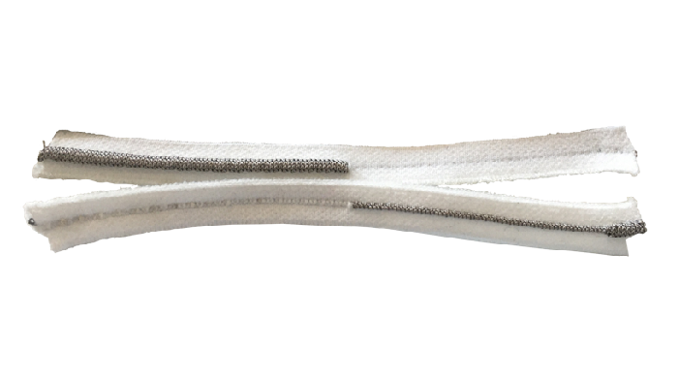
Prevayl technology
Sensor Innovation
Puck
Garment
App and Platform
6￼

Slide 7





Intellectual Property

Slide 8
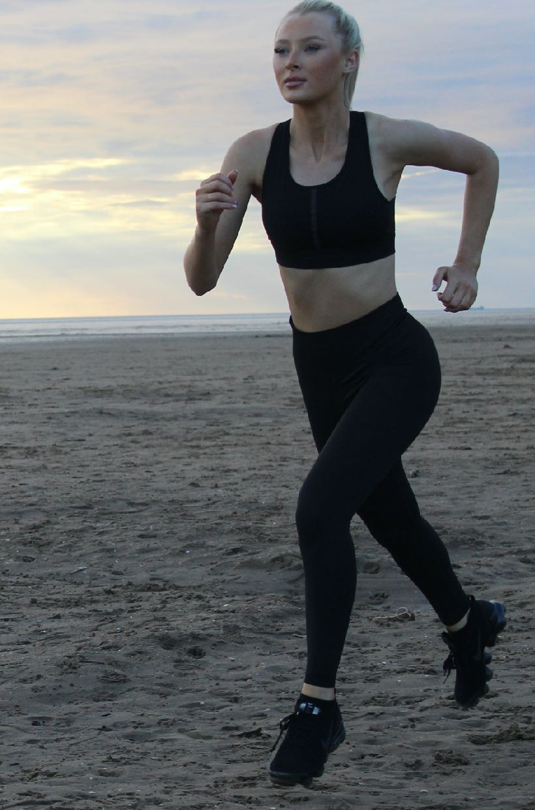
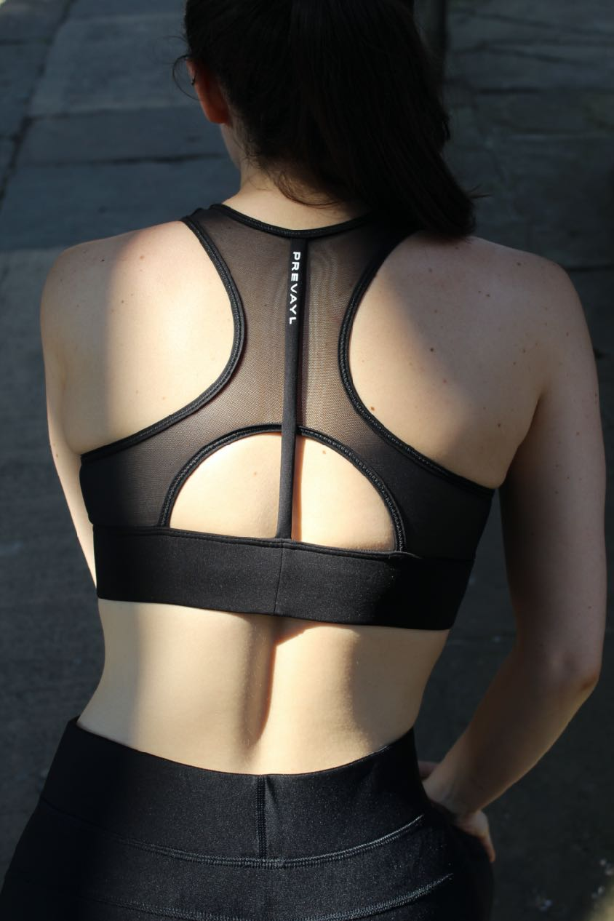
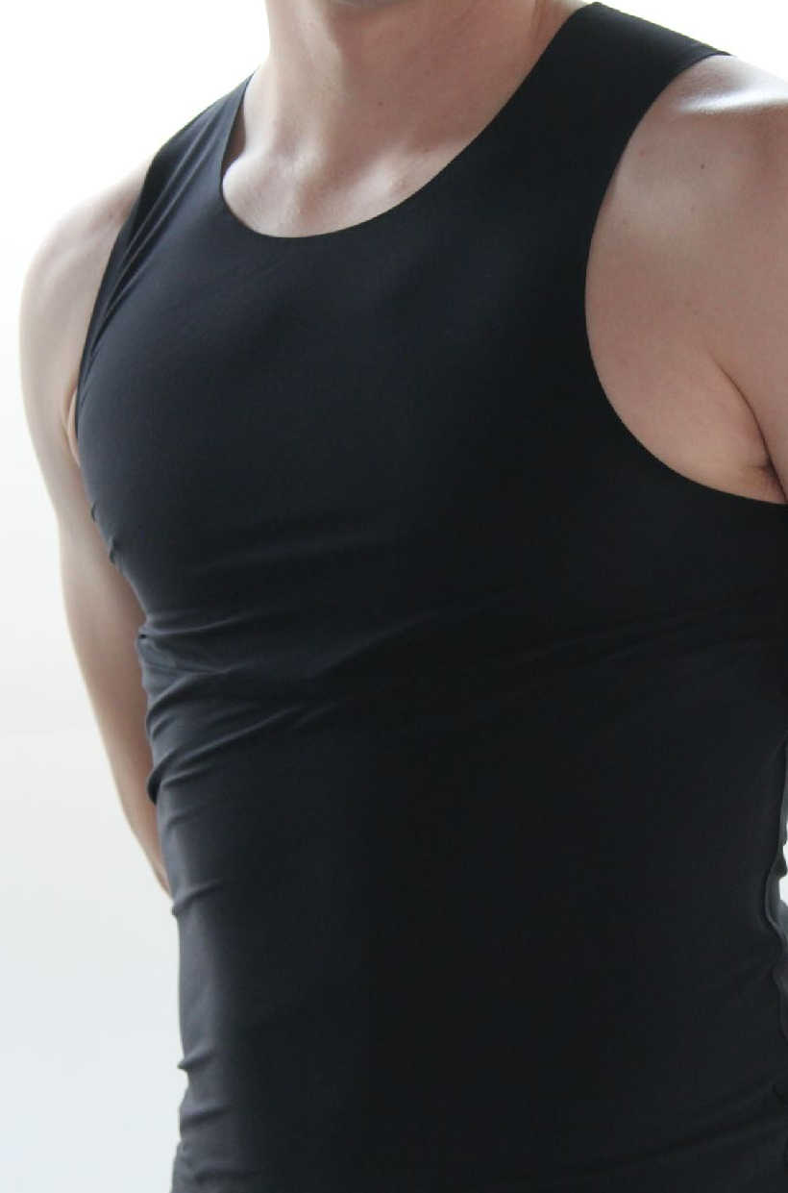
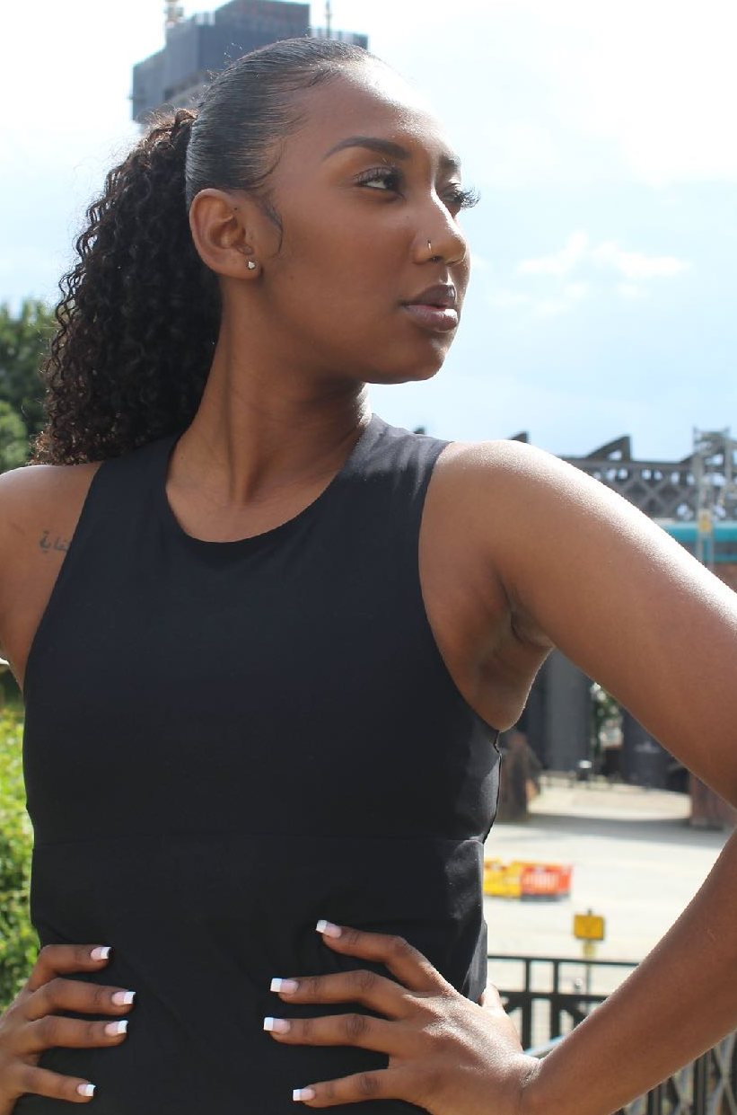
The collaboration of tech and fashion
8￼

Slide 9
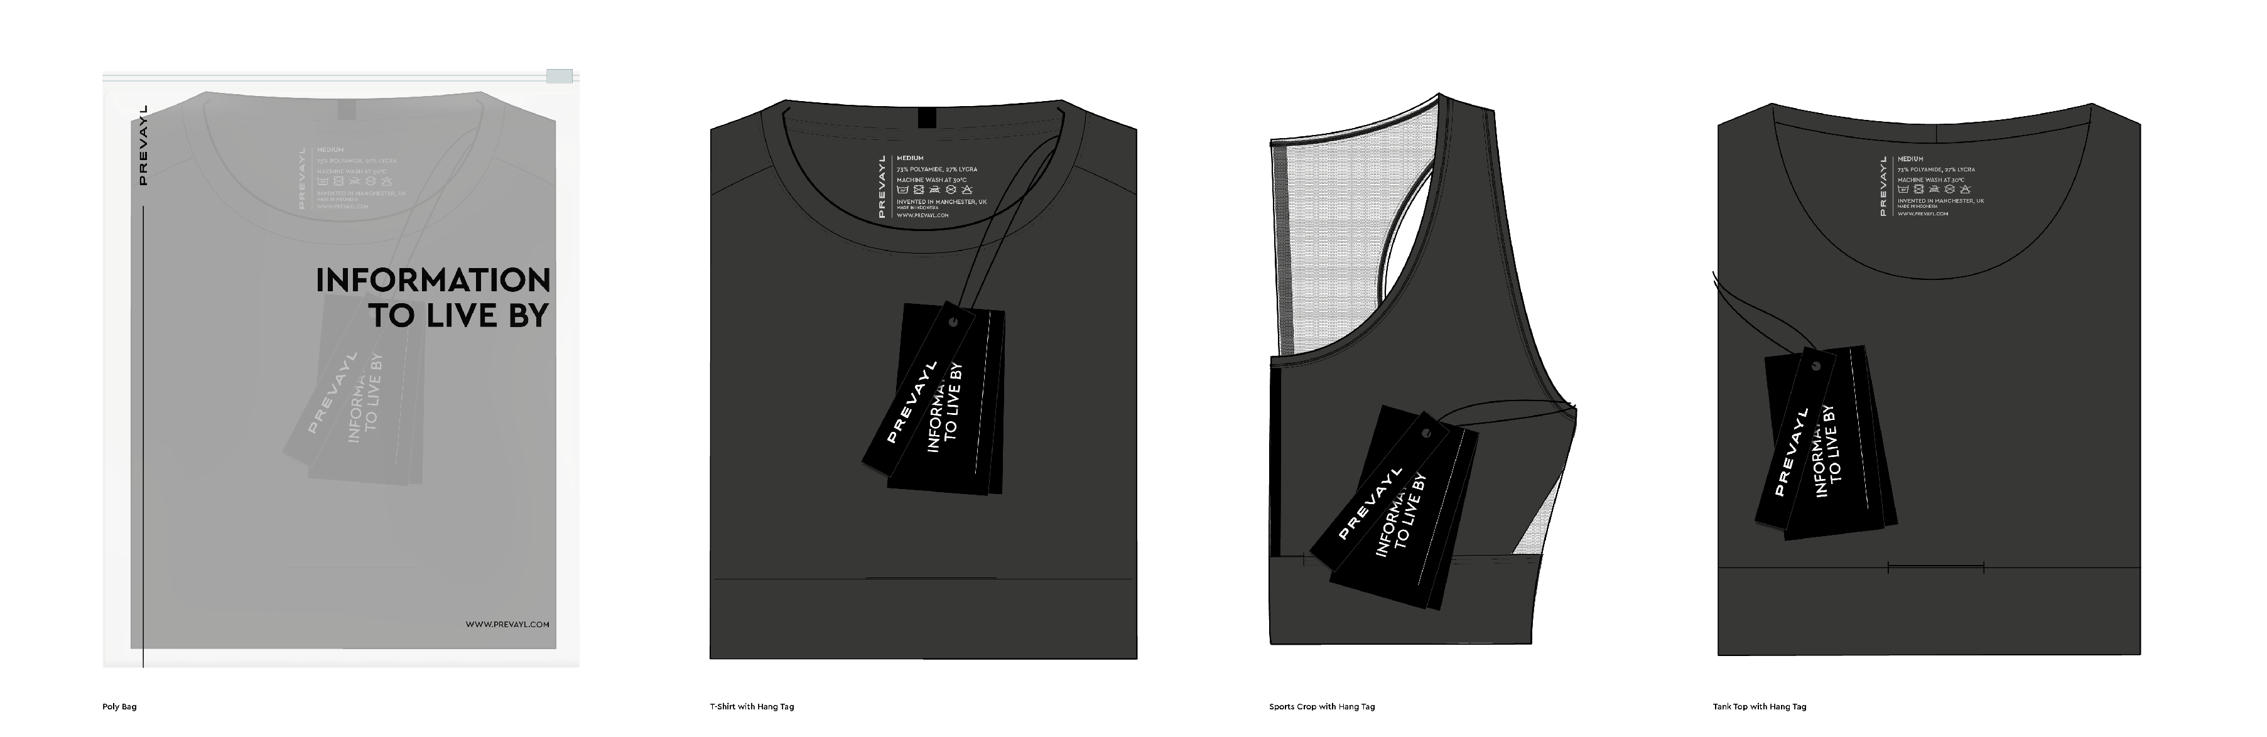
Building the Prevayl product
9￼

Slide 10
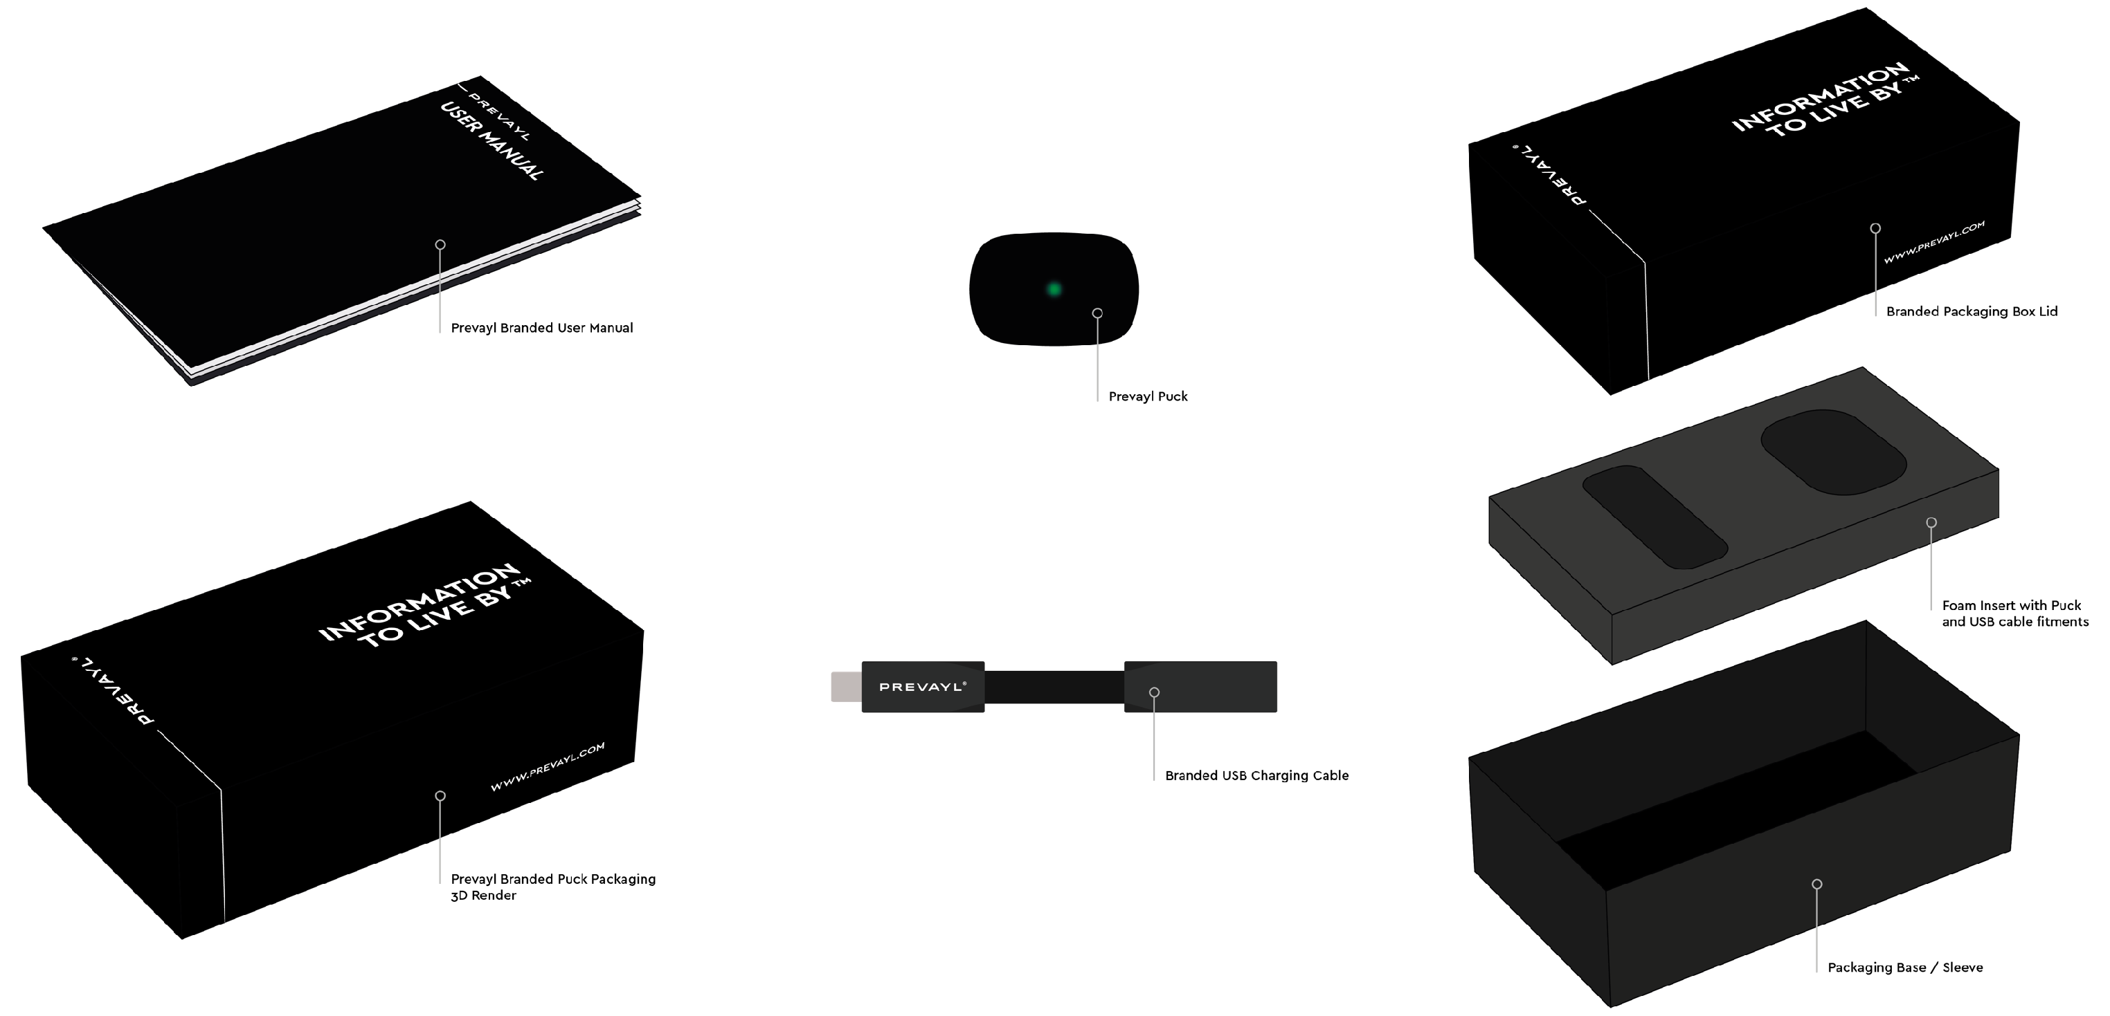
Building the Prevayl product
10￼

Slide 11





Prevayl staff
11￼

Slide 12






Prevayl insights
What our garments can tell you
Exercise Efficiency
Hydration
Exercise Readiness and Recovery Testing
Physical Stress
Mental Stress
Heart Health and Wellness Tracking
12￼

Slide 13
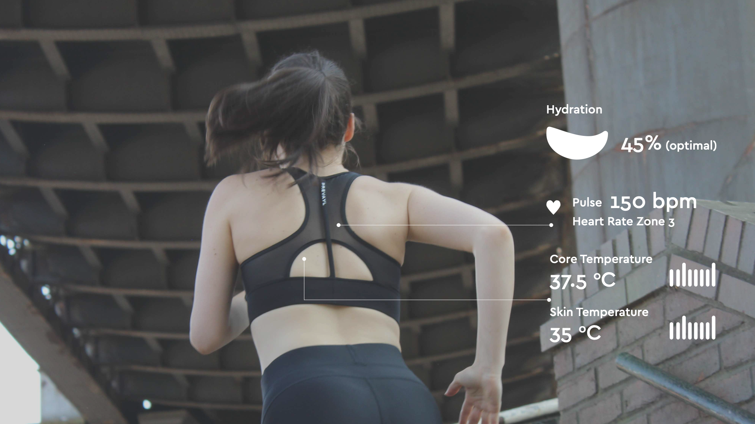
Performance and health
13￼

Slide 14

REVOLUTION
14￼

Slide 15

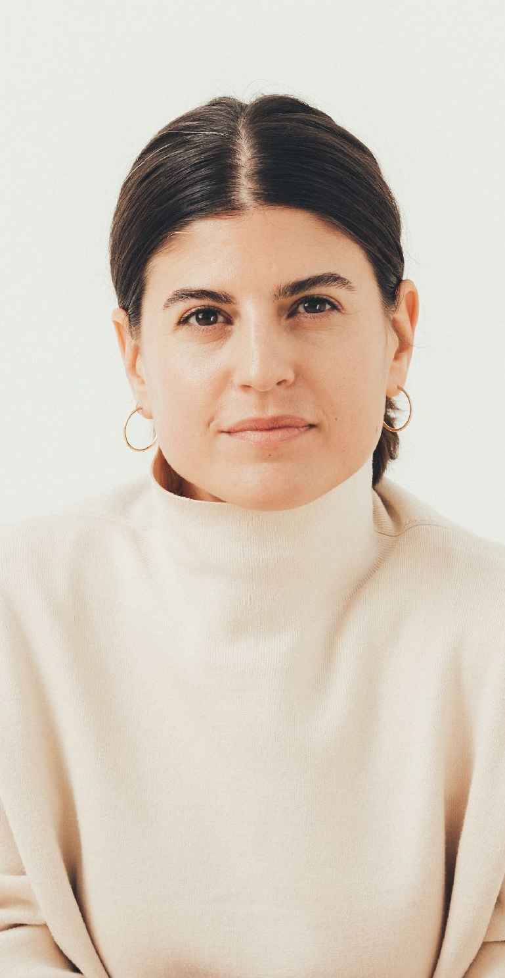
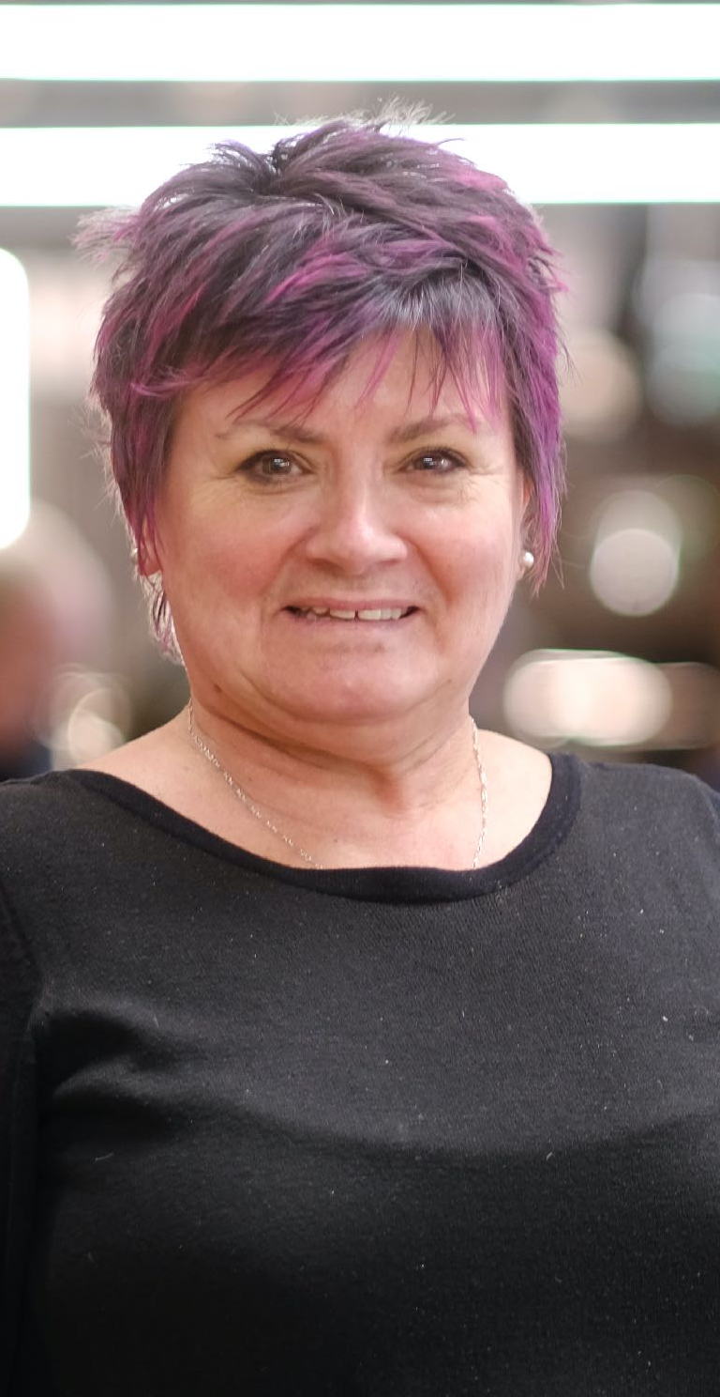
Women in Tech
15￼

Slide 16

Activity
Prevayl® invite you to create your idea of a piece of technology that could benefit humanity and improve the lives of people. This could be anything from a pair of trainers that monitors how much fun you’re having, to a hat that can help people’s mental health.
Get creative! at Prevayl we like to think that the sky is the limit and no idea is a bad one.
16￼

